Slide 2
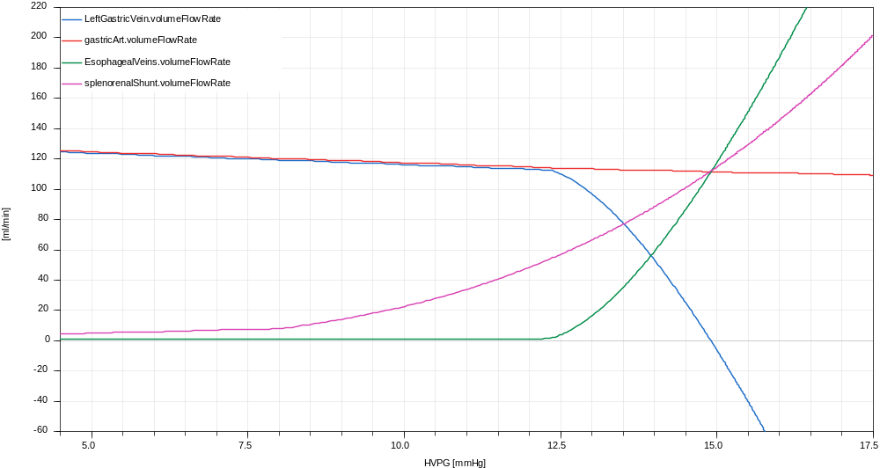
Esophageal shunts – arbitral parametrization
Do you have any data?

Slide 3
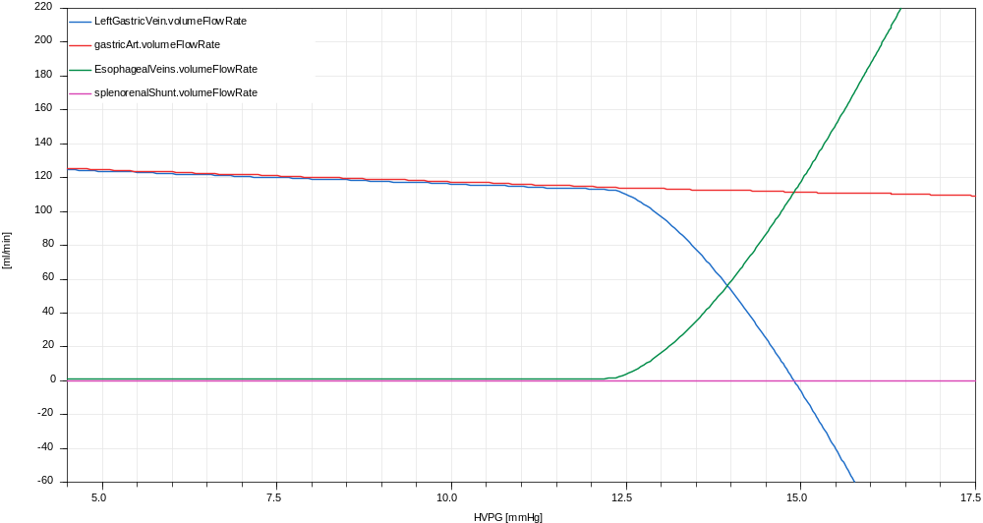
Esophageal shunts – no splenorenal shunt
The result is the same, as it is just relative to HVPG

